Slide 1
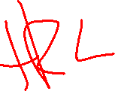
Neural Networks
David Quigley
CSCI 4622
2022 Spring

Slide 2
Course Logistics
Problem Set 3: 3/14 3/16 @ 11:59PM
Project Milestone 3: Due 4/8
Just a check-in, integrating feedback, etc.
Exam 1: Feedback Returned
Grades in Class…

Slide 3
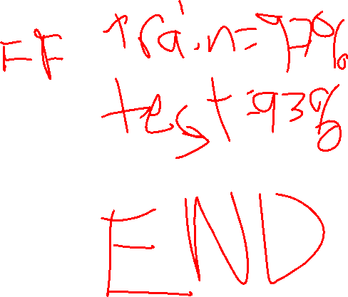
Coding Neural Nets

Slide 4
Reinforcement Learning
How to learn everything in one lecture*

Slide 5
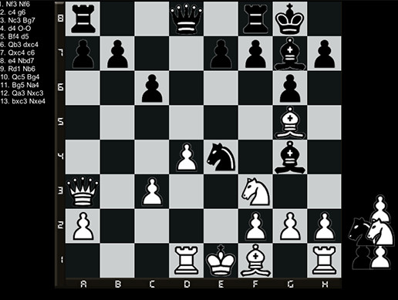
A Different Kind of Problem…
Complex decisions
Multi-step activity
steps are not independent
Multiple (Opposing) Players
Notes:
https://assetstorev1-prd-cdn.unity3d.com/key-image/3887a860-dbac-447f-8358-732a955e0e19.jpg

Slide 6
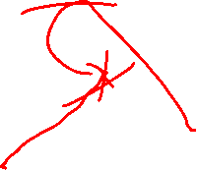
Defining Our Problem Space
Agent – A decision-making entity
Environment – The space in which the Agent is making decisions
State (S) – The current status of the Environment
Goal – An eventual outcome sought by the Agent
Reward (R) – Intermediate measure of success/failure towards the Goal
Action (A) – The options available to the Agent to change the State

Slide 7
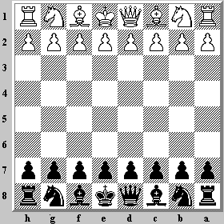
Action & State are Linked
What’s possible? vs
What’s effective?

Slide 8
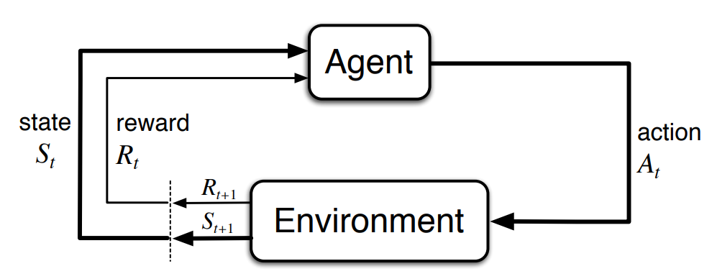
Markov Decision Processes
Notes:
http://incompleteideas.net/book/bookdraft2017nov5.pdf

Slide 9
Action + State = Policy
Policy (π) – The mapping of state to action

Slide 10
Expanding Reward
Reward – An intermediate measure of success / failure towards the Goal
Immediate & Future Rewards must both be considered
Value (V) – The expected long-term return of the current state (in terms of our policy π)
V(S) = Immediate Reward +
(Future Reward * Discount Factor)

Slide 11
Dealing with Value
A variety of factors can be given positive value
- distance to target
- existing intermediate rewards
- chess: removing an enemy piece
- video game: coin, powerup

Slide 12
Dealing with Value
A variety of factors can be given negative value
- bad “goals”
- game over, putting yourself into checkmate

Slide 13
Dealing with Value
A variety of factors can be given negative value
- bad “goals”
- game over, putting yourself into checkmate
- bad intermediate moves
- losing a piece

Slide 14
Dealing with Value
A variety of factors can be given negative value
- bad “goals”
- game over, putting yourself into checkmate
- bad intermediate moves
- losing a piece
- effort
- any move can have cost

Slide 15
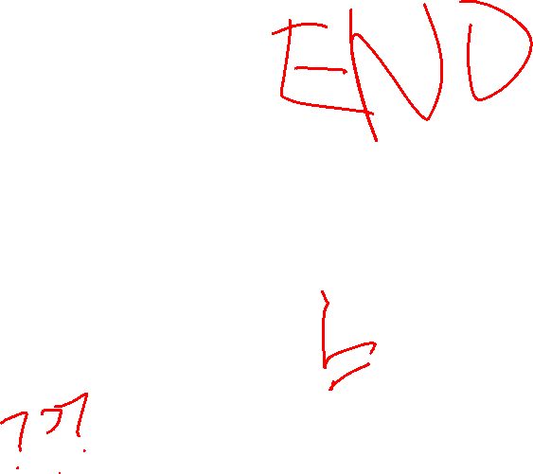
Dealing with Value
Black is considering two options
- Knight to F2
- Queen to D5
What happens if we value capturing pieces highly?
What happens if we avoid risk?
What happens 5 moves out???

Slide 16
Wednesday

Slide 17
Course Logistics
Problem Set 3: 3/14 3/16 @ 11:59PM
Project Milestone 3: Due 4/8
Just a check-in, integrating feedback, etc.
PS4 Not Yet Released
Will be later today, we will discuss details on Friday
Grades in Class…

Slide 18
Defining Our Problem Space
Agent – A decision-making entity
Environment – The space in which the Agent is making decisions
State (S) – The current status of the Environment
Goal – An eventual outcome sought by the Agent
Reward (R) – Intermediate measure of success/failure towards the Goal
Action (A) – The options available to the Agent to change the State

Slide 19
Expanding Reward
Reward – An intermediate measure of success / failure towards the Goal
Immediate & Future Rewards must both be considered
Value (V) – The expected long-term return of the current state (in terms of our policy π)
V(S) = Immediate Reward +
(Future Reward * Discount Factor)

Slide 20
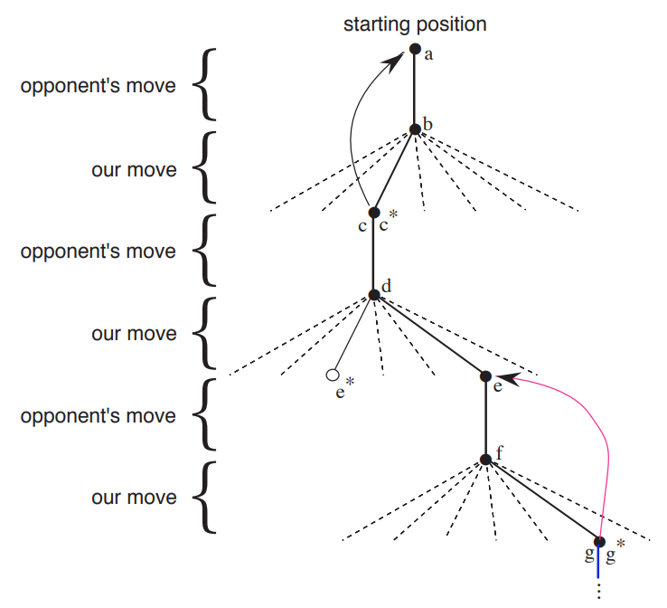
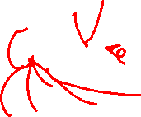
Expanding Reward
Each possible action can generate a Value (V)

Slide 21
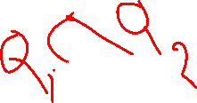
Expanding Reward
Each possible action can generate a Value (V)
Q-Value is the long-term return of a (State, Action) pair

Slide 22
Q ~ Decision Boundary
Q maps state + action = reward
From a state, choose the action with the best Q Value!

Slide 23
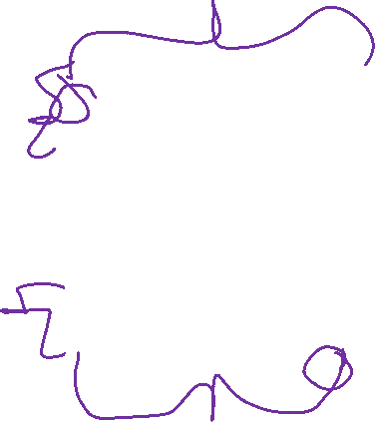
Q ~ Final Model
Q maps state + action = reward
From a state, choose the action with the best Q Value!

Slide 24
Developing Q

Slide 25
Developing Q
We have two feature sets to optimize
- Values for states
- Policies for how to act

Slide 26
Developing Q
We have two feature sets to optimize
- Values for states
- Policies for how to act
à la Backpropagation, let’s iterate through each one in turn!

Slide 27
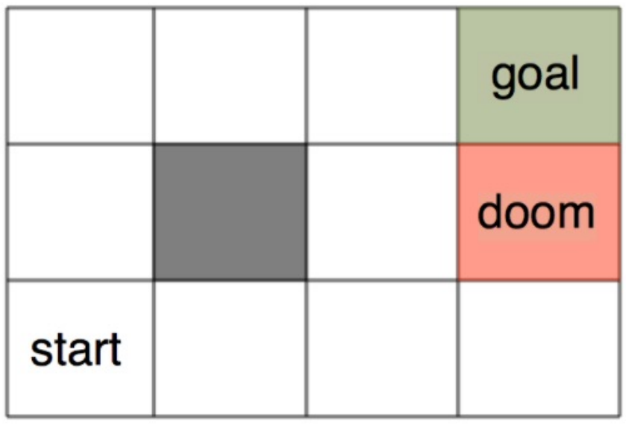
Developing Q – a Probabilistic Approach
Consider a maze world. How will our agent get from start to goal, without hitting doom?

Slide 28
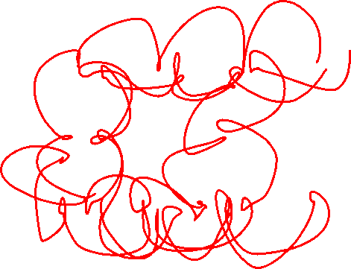
Developing Q – a Probabilistic Approach
Consider a maze world. How will our agent get from start to goal, without hitting doom?
(Yes, we could write a set of instructions for this world. But it could get too complicated, especially in a bigger world!)

Slide 29
Developing Q – a Probabilistic Approach
Consider a maze world. How will our agent get from start to goal, without hitting doom?
Move at random into a new space!

Slide 30
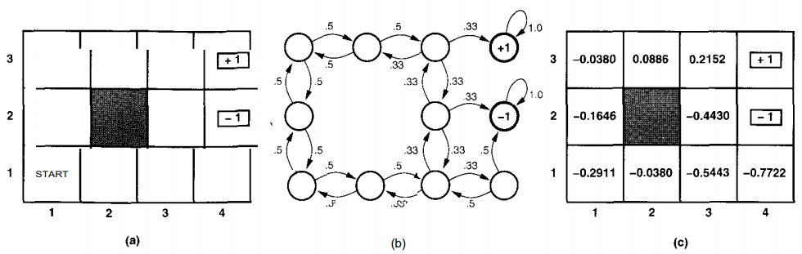

Developing Q – Updating Value
Notes:
https://www.cin.ufpe.br/~tfl2/artificial-intelligence-modern-approach.9780131038059.25368.pdf

Slide 31

Developing Q – Updating Value
Calculate out the probability of success or failure at each point
Notes:
https://www.cin.ufpe.br/~tfl2/artificial-intelligence-modern-approach.9780131038059.25368.pdf

Slide 32
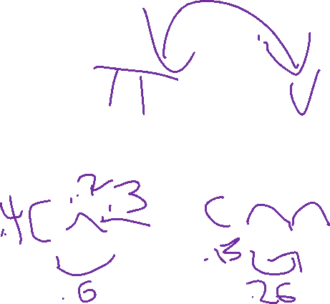
Developing Q – Updating Value
Calculate out the probability of success or failure at each point
Notes:
https://www.cin.ufpe.br/~tfl2/artificial-intelligence-modern-approach.9780131038059.25368.pdf

Slide 33
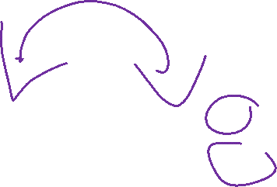
Developing Q – Updating Policy
You can use this approach to feed back into your decision policies!
Notes:
https://www.cin.ufpe.br/~tfl2/artificial-intelligence-modern-approach.9780131038059.25368.pdf

Slide 34
Problems to Address
Dealing with the problem of scale
Choosing our “features” to represent state
- easy in games, hard in the real world
Generalization

Slide 35
Dealing with Scale
How many States are there in the game of chess?
Notes:
https://math.stackexchange.com/questions/1406919/how-many-legal-states-of-chess-exists

Slide 36
Dealing with Scale
How many States are there in the game of chess?
7.7 * 10⁴⁵ according to John Tromp…
How much memory storage do you have?
Notes:
https://math.stackexchange.com/questions/1406919/how-many-legal-states-of-chess-exists

Slide 37
Dealing with Scale
How many States are there in the game of chess?
7.7 * 10⁴⁵ according to John Tromp…
How much memory storage do you have?
5e11(500 GB)? 1e12(1TB)?
We’re not approaching the storage capacity to actually hold all states!
Notes:
https://math.stackexchange.com/questions/1406919/how-many-legal-states-of-chess-exists

Slide 38
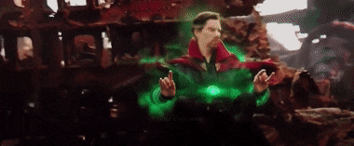
Scale – Monte Carlo Estimation
Instead of mapping out the full probability space, let’s generate a bunch of sample uses of our policy (to end-state) and use the outcomes to determine value!
Notes:
https://thumbs.gfycat.com/BetterThankfulEnglishsetter-max-1mb.gif

Slide 39
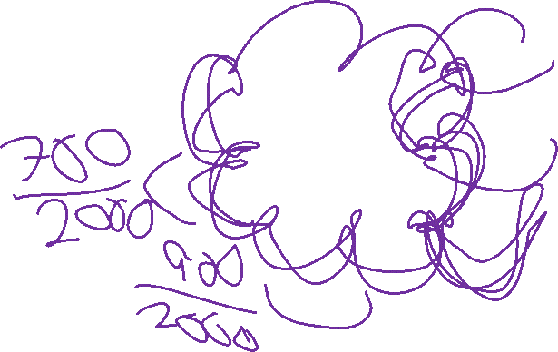
Developing Q – Monte Carlo

Slide 40
Scale – Temporal Differences
Instead of updating our value based on end-probability, we should update our value based on t+1’s probability

Slide 41
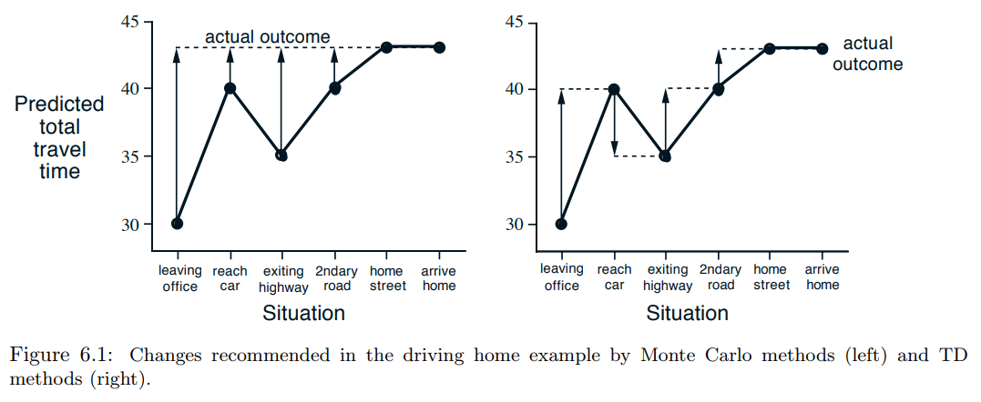
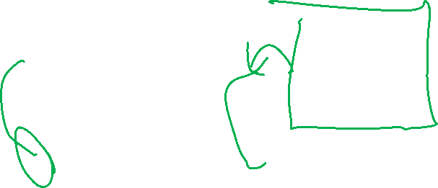
Monte Carlo vs. Temporal Difference

Slide 42
Developing Q – Temporal Differences

Slide 43
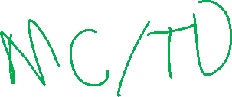
Problems to Address
Dealing with the problem of scale
Choosing our “features” to represent state
- easy in games, hard in the real world
Generalization

Slide 44
Problem Space Representation - Features

Slide 45
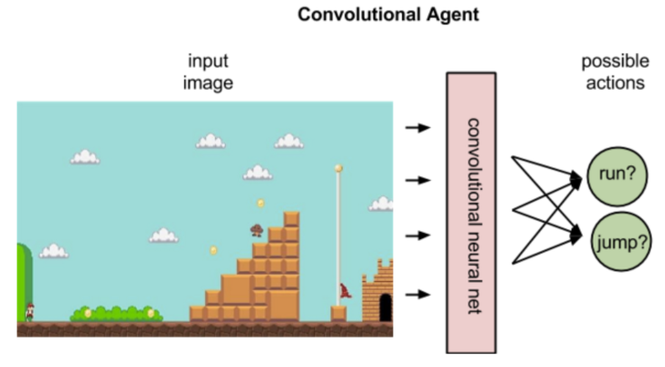
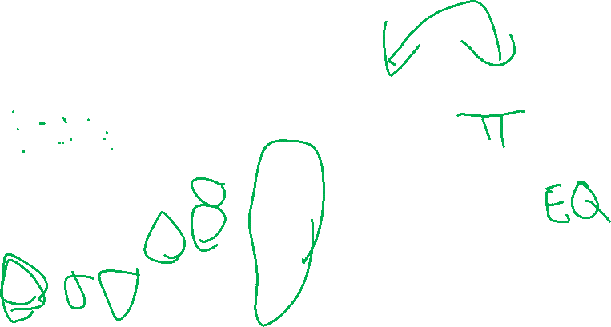
Problem Space – Video Games
Notes:
https://skymind.ai/wiki/deep-reinforcement-learning

Slide 46
Problems to Address
Dealing with the problem of scale
Choosing our “features” to represent state
- easy in games, hard in the real world
Generalization

Slide 47
Generalization
How have we avoided problems with missing samples in the past?

Slide 48
Generalization
How have we avoided problems with missing samples in the past?
Think back to Week 2!

Slide 49
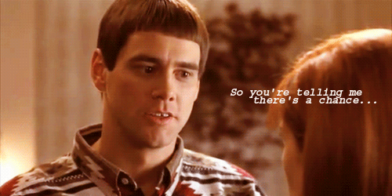
Overfitting Solutions - Smoothing
Builds on the assumption that “nothing is impossible”
Notes:
https://media.giphy.com/media/cT9tZDsVQL1II/giphy.gif

Slide 50
Clustering

Slide 51
Supervised vs. Unsupervised Learning
Supervised – ground truth X (features), Y (answer)
- Trying to get a machine to predict Y based on X
- Building / implementing a function to map X to Y
- Trying to capture the hidden structure

Slide 52
Supervised vs. Unsupervised Learning
Supervised – ground truth X (features), Y (answer)
- Trying to get a machine to predict Y based on X
- Building / implementing a function to map X to Y
- Trying to capture the hidden structure
Discrete Continuous
Classification Regression
- divide my samples into classes - generate a continuous value

Slide 53
Supervised vs. Unsupervised Learning
Supervised – ground truth X, Y
- Trying to get a machine to predict Y based on X
- Building / implementing a function to map X to Y
- Trying to capture the hidden structure
Unsupervised – ground truth X
- No ground truth Y*
- Building / implementing a function to model hidden structure
*Ground truth may actually exist, we just a) can’t capture it, or b) are choosing to not use it for our task

Slide 54
Clustering
Clustering – ground truth X
- No ground truth Y*
- Trying to develop classes from the bottom up
- Trying to build based on hidden structure
*Ground truth may actually exist, we just a) can’t capture it, or b) are choosing to not use it for our task

Slide 55
Clustering
Clustering – ground truth X
- No ground truth Y*
- Trying to develop classes from the bottom up
- Trying to build based on hidden structure
Finding clusters such that
- Examples within a cluster are similar
- Examples between clusters are dissimilar
*Ground truth may actually exist, we just a) can’t capture it, or b) are choosing to not use it for our task

Slide 56

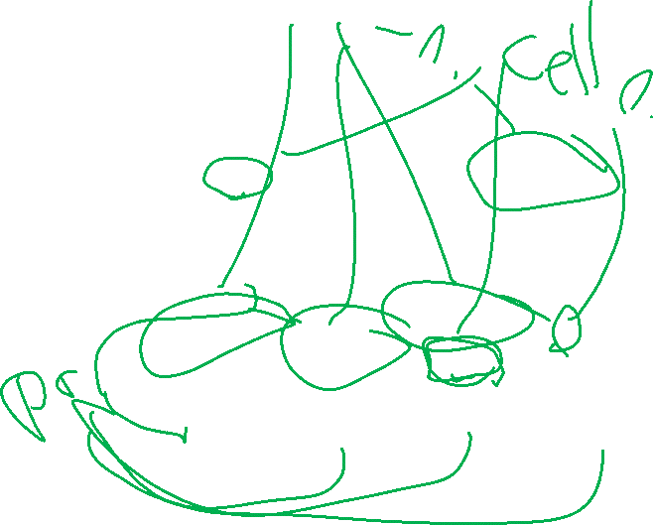
Clustering Examples

Slide 57
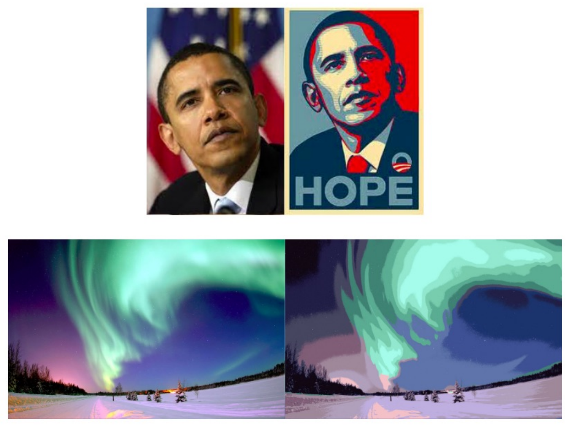
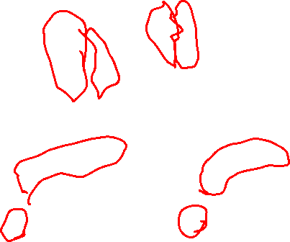
Clustering Examples

Slide 58
Clustering
Clustering – ground truth X
- No ground truth Y*
- Trying to develop classes from the bottom up
- Trying to build based on hidden structure
Finding clusters such that
- Examples within a cluster are similar
- Examples between clusters are dissimilar
*Ground truth may actually exist, we just a) can’t capture it, or b) are choosing to not use it for our task

Slide 59
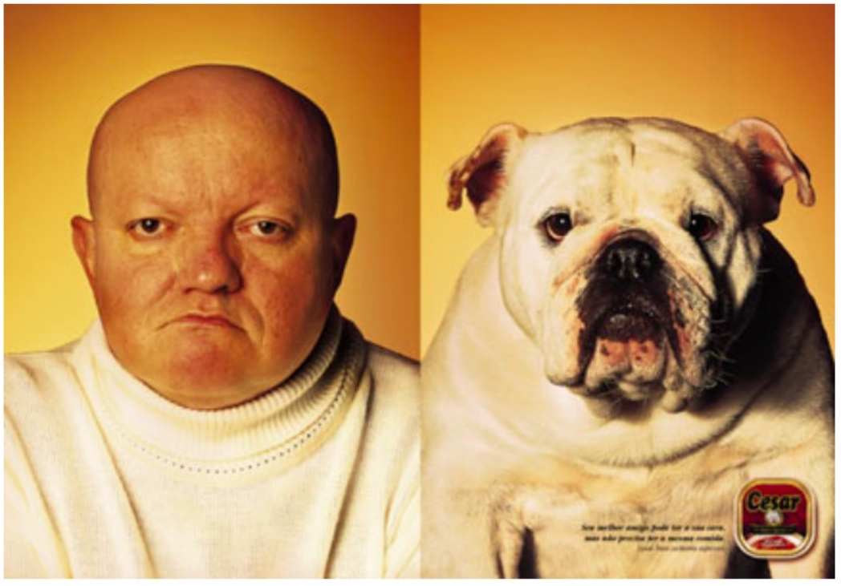

Clustering – Examples of Similarity
Eyeball test

Slide 60
Clustering – Examples of Similarity
Eyeball test
Not something we can calculate

Slide 61
Clustering – Examples of Similarity
Euclidian Distance = ||x – y ||²

Slide 62
Clustering – Examples of Similarity
Euclidian Distance = ||x – y ||²
Edit Distance: Number of character changes (insert, delete, edit) to convert string x to string y

Slide 63

Clustering – Examples of Similarity
Euclidian Distance = ||x – y ||²
Edit Distance: Number of character changes (insert, delete, edit) to convert string x to string y
Sit to Cart
Cit
Cat
Cart

Slide 64
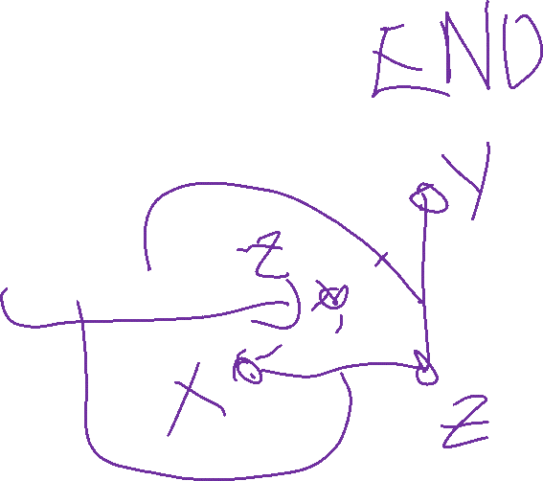
Clustering – Similarity Rules
Given a distance measure d(x,y)
Symmetry: d(x,y) = d(y,x)
Self Consistency: d(x,x) = 0
Positivity: d(x,y) = 0 if x = y
Triangle Inequality: d(x,y) <= d(x,z) + d(z,y)

Slide 65
Friday

Slide 66
Course Logistics
Problem Set 4: 4/4 @ 11:59PM
Project Milestone 3: Due 4/8
Just a check-in, integrating feedback, etc.

Slide 67
Problem Set 4
Kaggle Competition
Classifying rocks by image

Slide 68

Problem Set 4 Evaluation
Getting on the board: 25%
Getting above .025 (our baseline): 50%
Getting above .07: 70%
Getting above .10: 80%
Getting above .25: 90%
Getting above .50: 100%
BONUS POINTS: for each .01 above .70, you get 5 bonus points
The maximum here is to get 5 instances of this.
If you get to .75 or higher, then your points are capped.
The "top 25% in the class" gets 10 additional bonus points

